Slide 1
What is an Event?
Change in the state of an object is known as event i.e. event describes the change in state of source.
Events are generated as result of user interaction with the graphical user interface components.
For example, clicking on a button, moving the mouse, entering a character through keyboard, selecting an item from list, scrolling the page are the activities that causes an event to happen.

Slide 2
What is Event Handling?
Event Handling is the mechanism that controls the event and decides what should happen if an event occurs.
This mechanism have the code which is known as event handler that is executed when an event occurs.
Java Uses the Delegation Event Model to handle the events. This model defines the standard mechanism to generate and handle the events.

Slide 3
Event handling models
Till now two models have been introduced in Java for receiving and processing events. The event handling mechanisms of these models differ a lot from each other.
Java 1.0 Event Model
Delegation Event Model

Slide 4
Java 1.0 Event Model
The Java 1.0 Event model for event processing was based on the concept of containment.
In this approach, when a user-initiated event is generated it is first sent to the component in which the event has occurred. But in case the event is not handled at this component, it is automatically propagated to the container of that component.
This process is continued until the event .is processed or it reaches the root of the containment hierarchy

Slide 5
Java 1.0 Event Model
For example, as shown in the next slide, Button is contained in the Panel which itself is contained within the Frame.
When the mouse is clicked on Button, an event is generated which is first sent to the Button. If it is not handled by it then this event is forwarded to the Panel and if it cannot handle the event, it is further sent to the Frame.
Frame being the root of the given hierarchy processes this event. So the event is forwarded up the containment hierarchy until it is handled by a component.

Slide 6
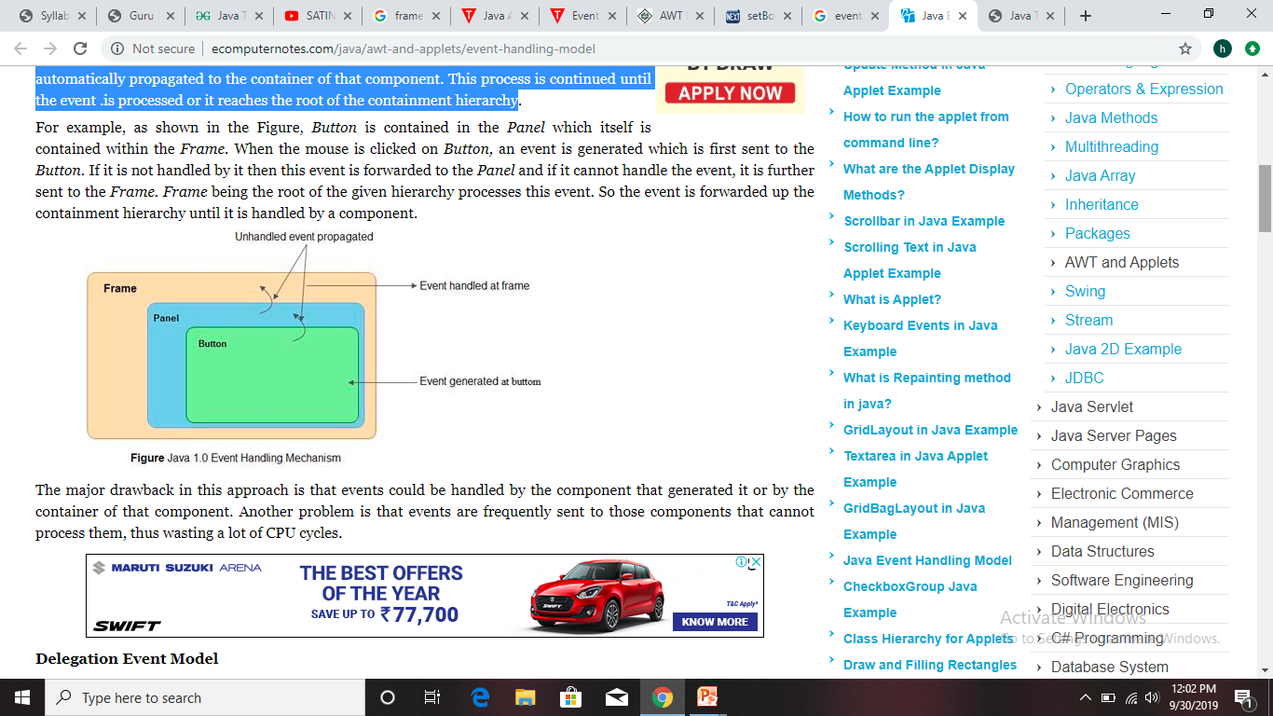
Java 1.0 Event Model

Slide 7
Java 1.0 Event Model
The major drawback in this approach is that events are frequently sent to those components that cannot process them, thus wasting a lot of CPU cycles.

Slide 8
Delegation Event Model
The advanced versions of Java ruled out the limitations of Java 1.0 event model. This model is referred to as the Delegation Event Model which defines a logical approach to handle events.
It is based on the concept of source and listener. A source generates an event and sends it to one or more listeners. On receiving the event, listener processes the event and returns it.
The notable feature of this model is that the source has a registered list of listeners which will receive the events as they occur. Only the listeners that have been registered actually receive the notification when a specific event is generated.

Slide 9
Delegation Event Model
For example, as shown in Figure, when the mouse is clicked on Button, an event is generated.
If the Button has a registered listener to handle the event, this event is sent to Button, processed and the output is returned to the user. However, if it has no registered listener the event will not be propagated upwards to Panel or Frame.

Slide 10
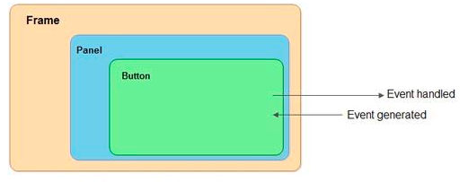
Delegation Event Model

Slide 11
Steps involved in event handling(Delegation event model)
The User clicks the button and the event is generated.
Now the object of concerned event class is created automatically and information about the source and the event get populated with in same object.
Event object is forwarded to the method of registered listener class.
the method is now get executed and returns.

Slide 12
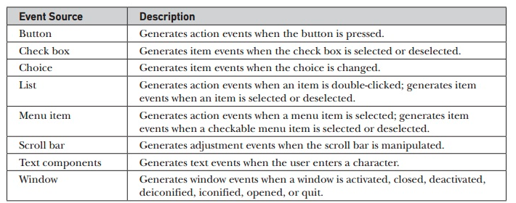
Sources of events

Slide 13
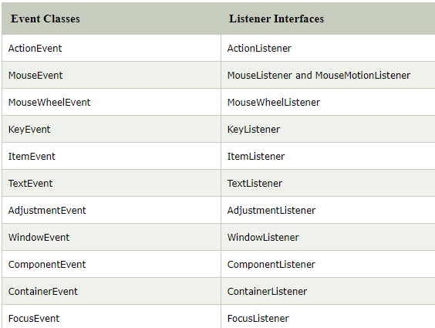
Event Classes and Listener Interfaces

Slide 14
Listener interface examples
https://www.youtube.com/watch?v=hrh9-oIBr6A

Slide 15
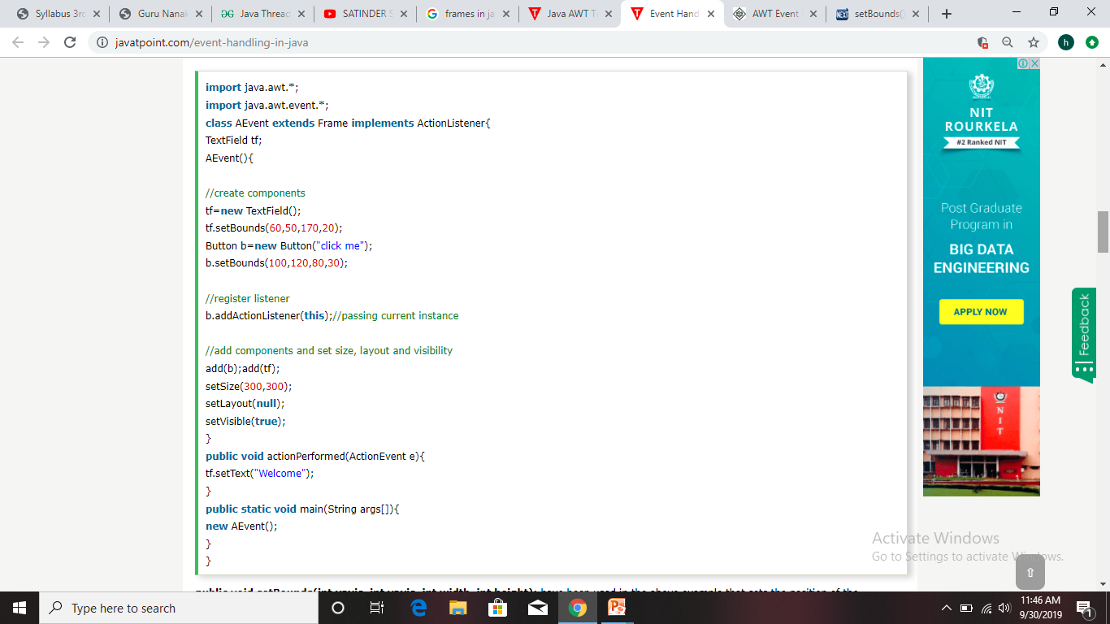
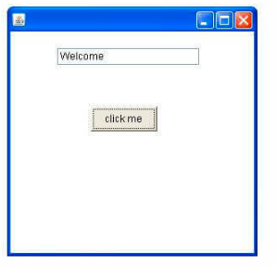
Output

Slide 16
KeyEvent
On entering the character the Key event is generated. There are three types of key events which are represented by the integer constants. These key events are following
KEY_PRESSED
KEY_RELEASED
KEY_TYPED

